Slide 1
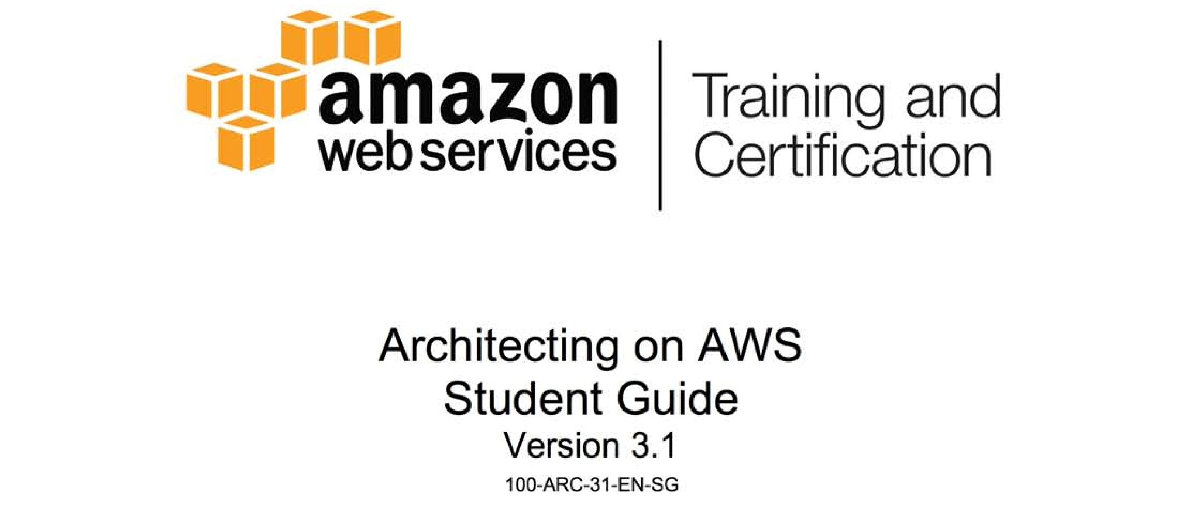

Slide 2

Module A: Reference Architecture

Slide 3
DocStore
by aMedia Corp.

Slide 4
DocStore
aMedia DocStore allows customers to upload and manage their documents

Slide 5
DocStore
aMedia DocStore allows customers to upload and manage their documents
Upload and access content from anywhere – browser and mobile apps
PDF, Office docs, images, videos – text content extracted, indexed, and searchable

Slide 6
DocStore
Two Account Types
Free
5GB storage
Search on name, created/modified, and tags
No full-text indexing
All content may be securely downloaded by owner

Slide 7
DocStore
Two Account Types
Premium
20GB storage
Full-text indexing and search for all documents (OCR on images)
All content may be securely downloaded by owner

Slide 8
DocStore
Two Major Components

Slide 9
DocStore
#1: Web Application
Allow users to upload, manage, and view all documents
All content uploaded directly to S3

Slide 10
DocStore
#1: Web Application
Both powered by public DocStore API
Both must scale
Both must be highly available

Slide 11
DocStore
#1: Web Application
Multi-region deployment for global support
User can log in to any region
Always redirected to “home” region (i.e., region where account was created)

Slide 12
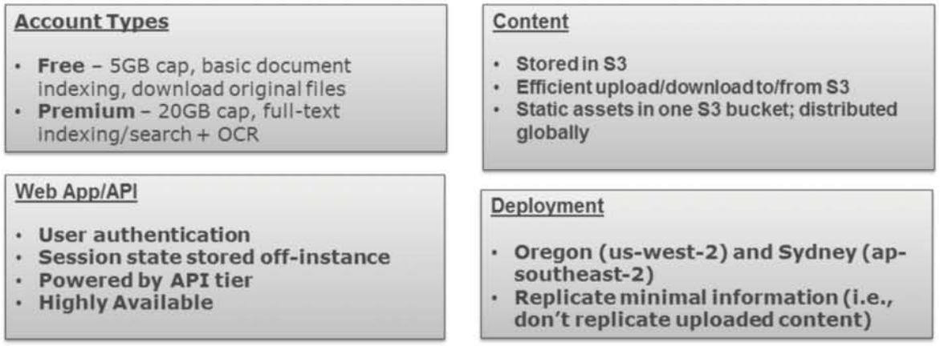
DocStore Requirements

Slide 13
DocStore
Sample Architecture

Slide 14
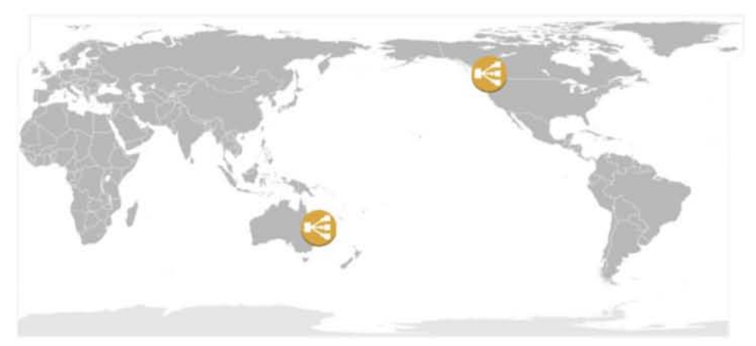
DocStore
Application deployed in two regions: us-west-2 (Oregon) and ap-southeast-2 (Sydney)

Slide 15

DocStore
Each ELB has a region-specific CNAME in Route 53

Slide 16

DocStore
Latency Based Routing feature of Route 53 directs customers to closest endpoint

Slide 17
DocStore
Closer to Oregon? That’s where you go. In Perth? Head to the ELB in Sydney.

Slide 18
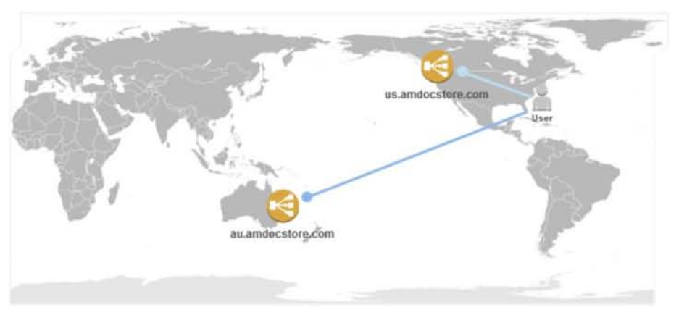
DocStore
Closer to Oregon? That’s where you go.

Slide 19
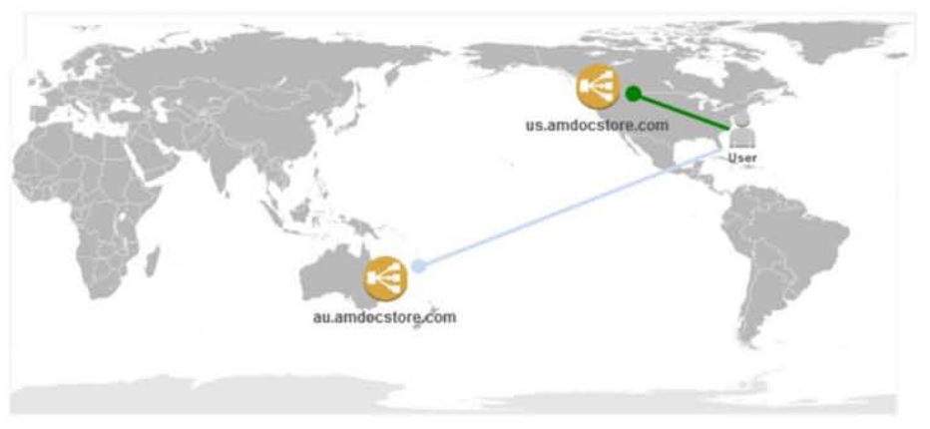
DocStore
Closer to Oregon? That’s where you go.

Slide 20

DocStore
Let’s focus on one region

Slide 21
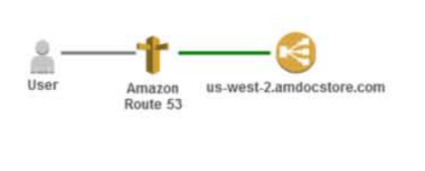
DocStore
Route 53 LBR directs a user to the nearest Elastic Load Balancer (in this case, the ELB in us-west-2)

Slide 22
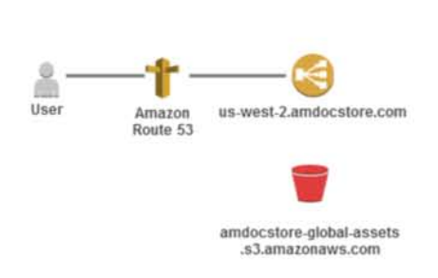
DocStore
DocStore stores all static web assets (CSS, images, JavaScript, etc.) in S3

Slide 23
DocStore
This bucket exists in the us-west-2 origin, but is the canonical source for static asset requests globally

Slide 24
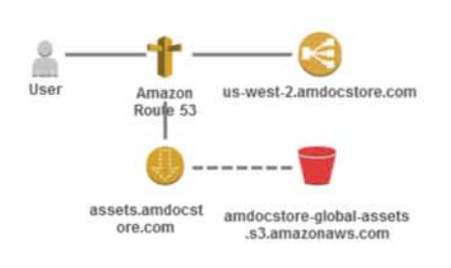
DocStore
CloudFront distributes static web assets in S3 to end users with low latency using a global network of edge locations

Slide 25
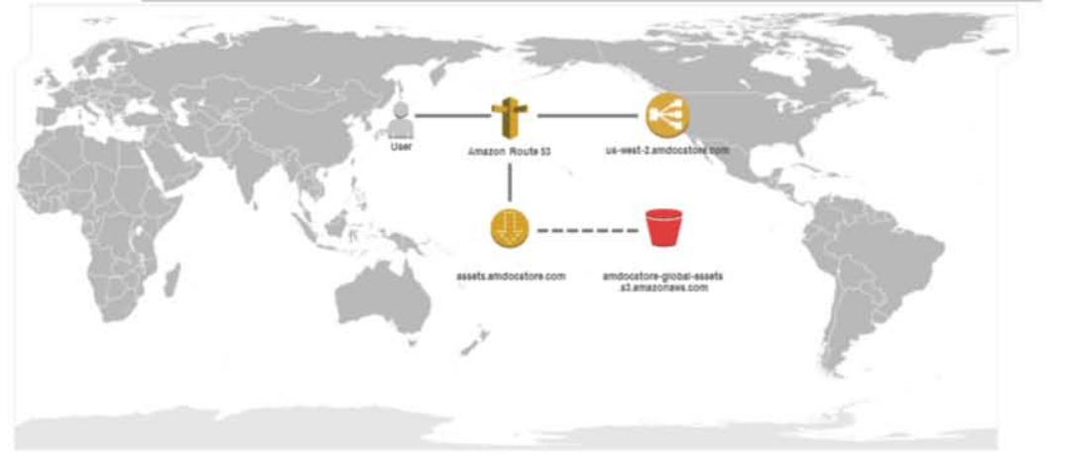
DocStore
Let’s see how a user in Tokyo would access http://assets.amdocstore.com/css/style.css

Slide 26
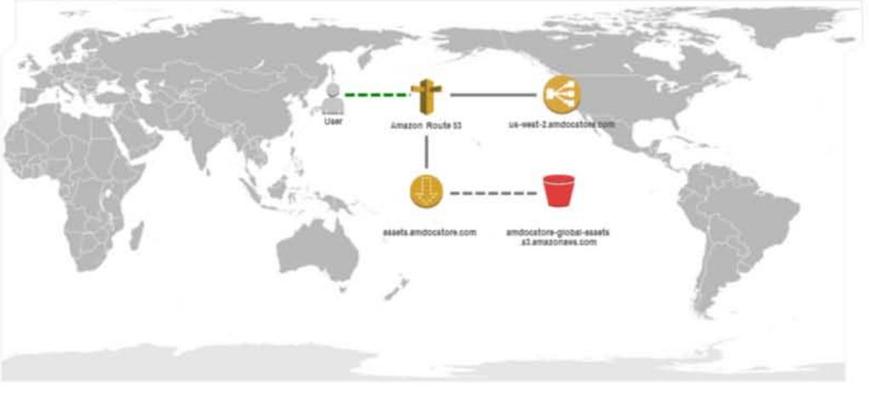
DocStore
Any user request for assets.amdocstore.com will automatically route to the nearest edge location

Slide 27
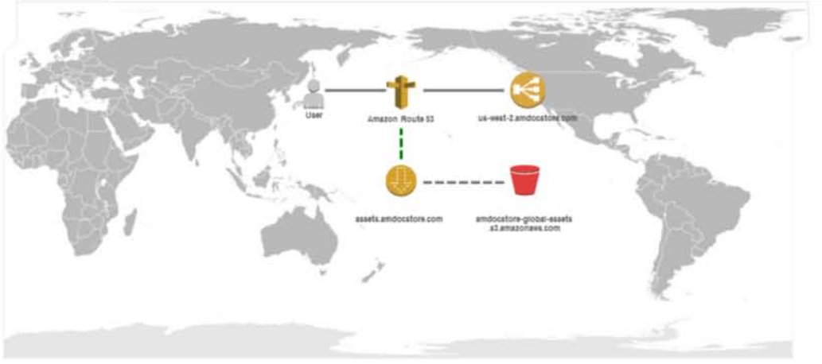
DocStore
Any user request for assets.amdocstore.com will automatically route to the nearest edge location

Slide 28
DocStore
Any user request for assets.amdocstore.com will automatically route to the nearest edge location

Slide 29
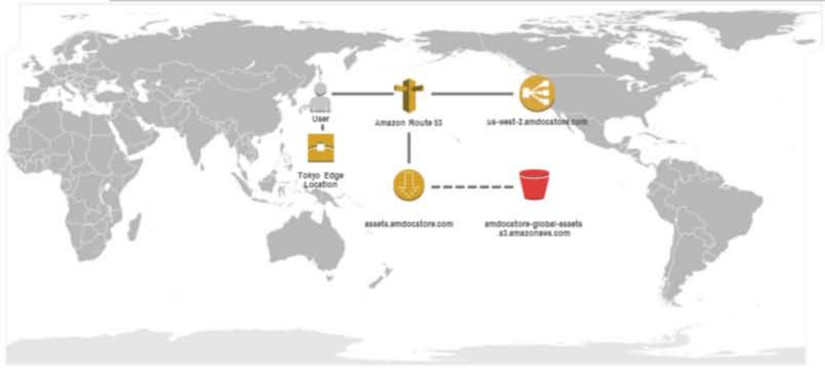
DocStore
Any user request for assets.amdocstore.com will automatically route to the nearest edge location

Slide 30
DocStore
The requested file will be served from the Tokyo edge if it is in the cache

Slide 31
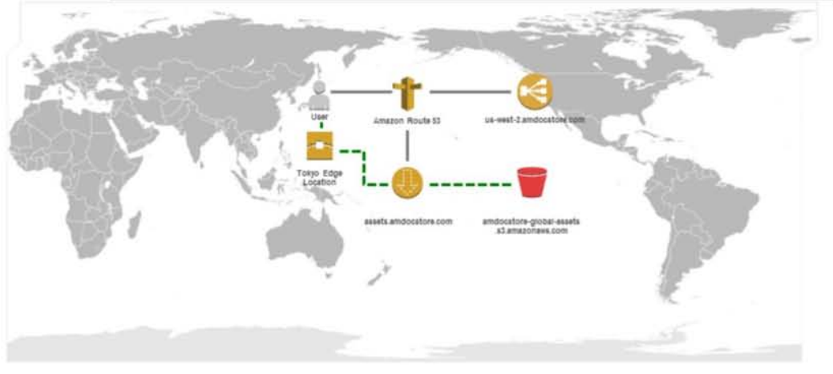
DocStore
The requested file will be served from the Tokyo edge if it is in the cache, or retrieved from the origin and cached at the edge for future requests

Slide 32
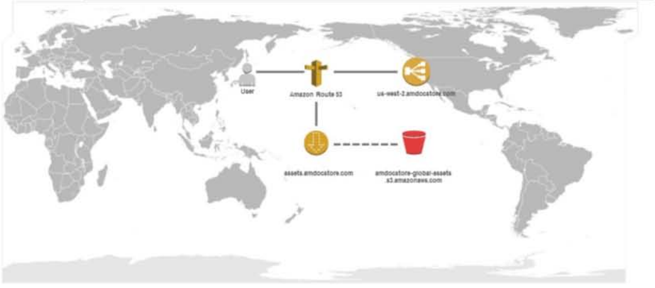
DocStore
Let’s go back to our application deployment in us-west-2

Slide 33
DocStore
Let’s go back to our application deployment in us-west-2

Slide 34
DocStore
Let’s go back to our application deployment in us-west-2 and focus on the browser component of DocStore

Slide 35
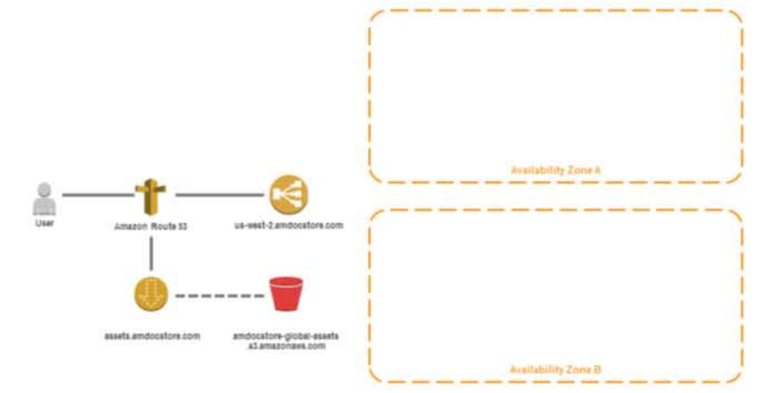
DocStore
Web servers will be deployed across multiple Availability Zones using Auto Scaling

Slide 36
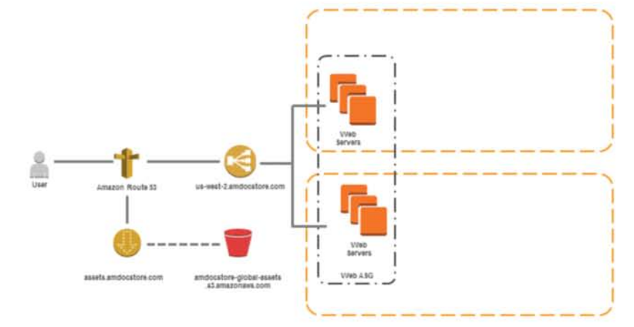
DocStore
Web servers will be deployed across multiple Availability Zones using Auto Scaling

Slide 37
DocStore
Web servers host the DocStore Interface that users will access with their web browsers

Slide 38

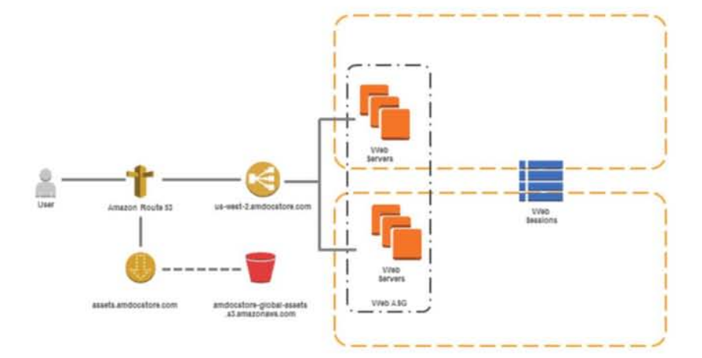
DocStore
Session state is stored out of the web tier in a DynamoDB table. DynamoDB is a regional service, meaning the data is automatically distributed across AZs

Slide 39
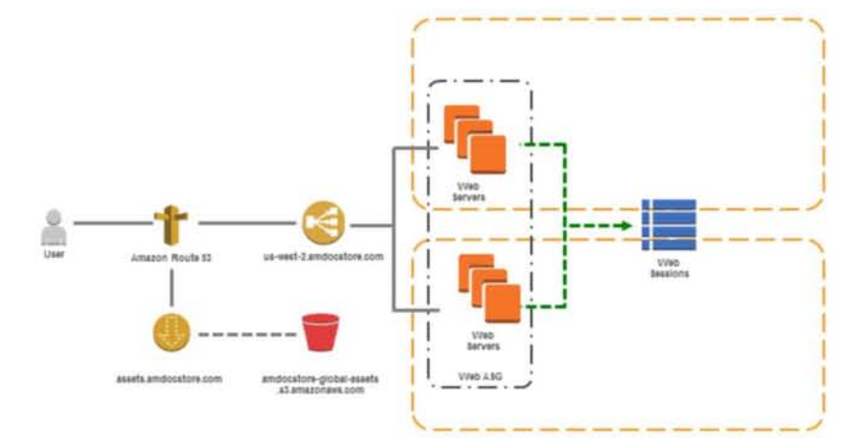
DocStore
Session state is stored out of the web tier in a DynamoDB table. DynamoDB is a regional service, meaning the data is automatically distributed across AZs

Slide 40
DocStore
Core functionality is provided by the DocStore API. Web servers consume this API

Slide 41
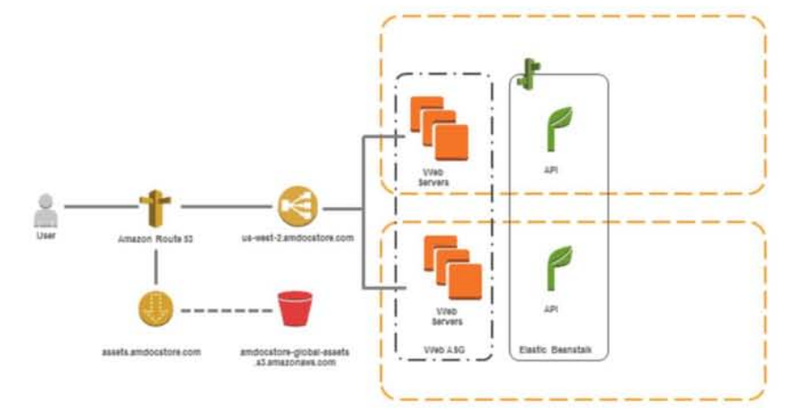
DocStore
The DocStore API will be deployed as an application in Elastic Beanstalk container

Slide 42

DocStore
Elastic Beanstalk provides Multi-AZ deployment, Auto Scaling, and load balancing

Slide 43
DocStore
Elastic Beanstalk supports Java, .NET, Python, PHP, Ruby, and node.js applications

Slide 44
DocStore
The API will use several different data stores for different types of data

Slide 45
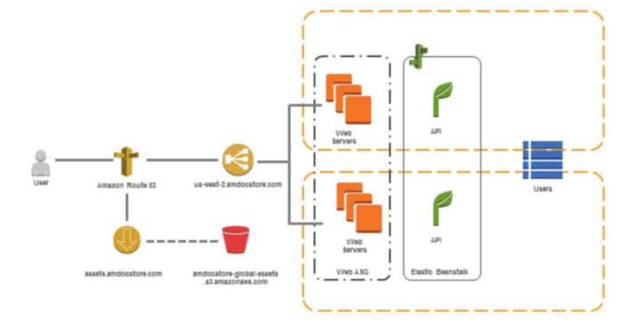
DocStore
User account information will be stored in a DynamoDB table

Slide 46
DocStore
Let’s see what happens when a new user signs up for DocStore

Slide 47
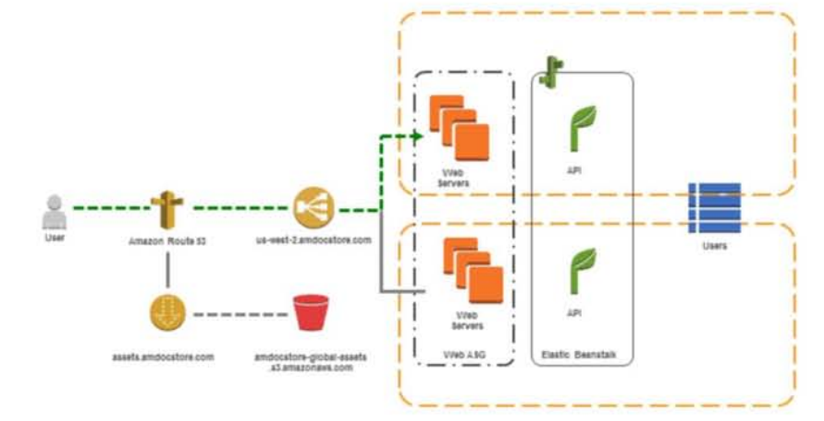
DocStore
Create Account: User submits sign-up form to web servers with username, password, etc.

Slide 48
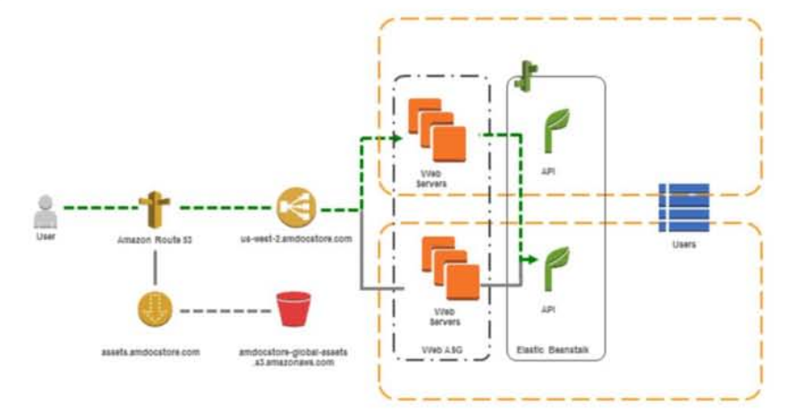
DocStore
Create Account: Web servers invoke CreateAccount API

Slide 49
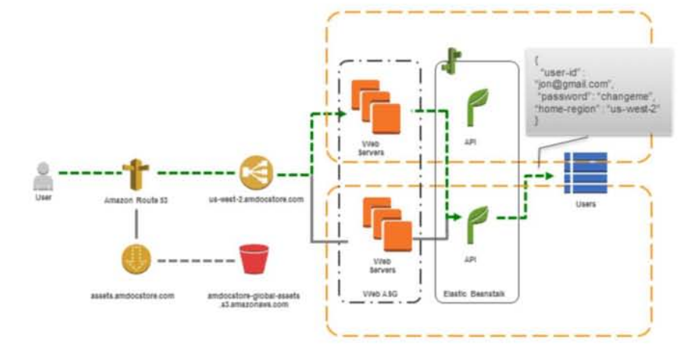
DocStore
Create Account: API creates a new item in the datastore

Slide 50
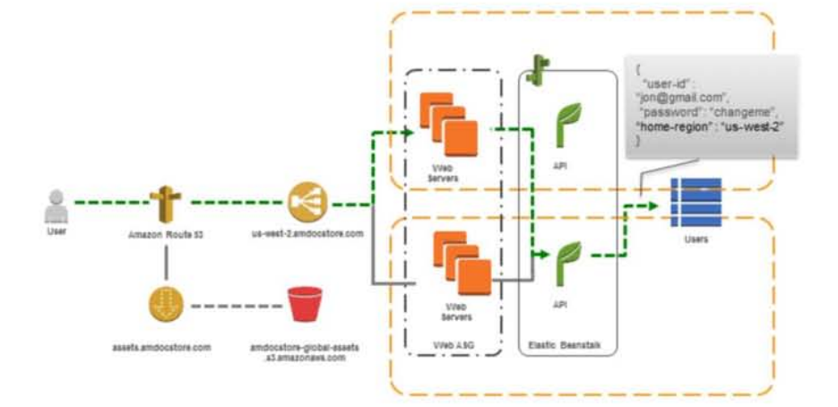
DocStore
Create Account: The API app deployed in Elastic Beanstalk has a configuration setting making it aware of the region it is running in

Slide 51
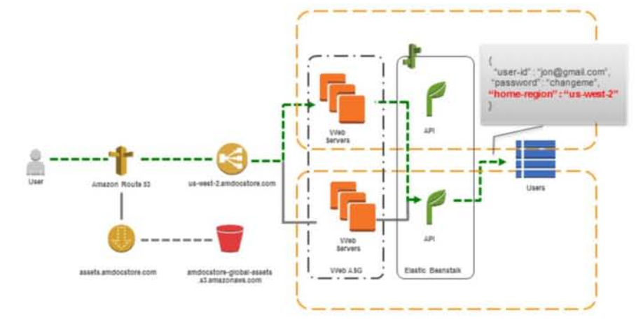
DocStore
Create Account: In addition to standard information, the API stores the user’s “home region”, i.e., the region the user signed up in

Slide 52
DocStore
Create Account: Replicating account data to our Sydney deployment will allow the API in that region to redirect the user to his home region if he ever accesses from there

Slide 53
DocStore
Create Account: We’ll consider account signup an event that other components of our application might be interested in.

Slide 54
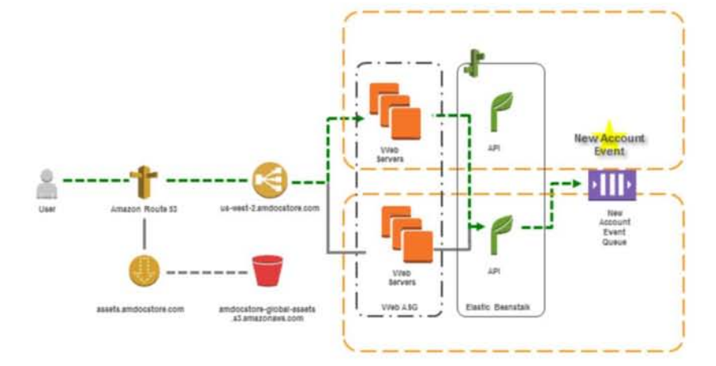
DocStore
Create Account: We’ll let listeners interested in the event (i.e., a cross-region account replication service) receive the event by putting a message in a queue

Slide 55
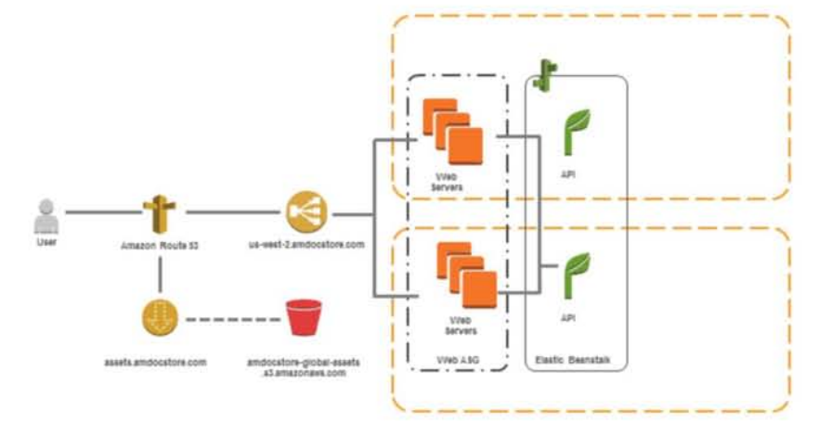
DocStore
Documents uploaded by a user are stored in an S3 bucket

Slide 56
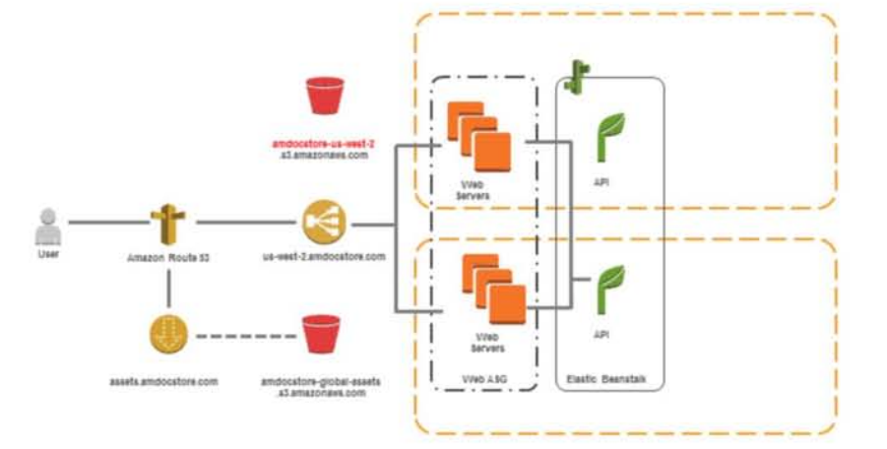
DocStore
The S3 bucket name includes the name of the region it was created it in.

Slide 57
DocStore
The S3 bucket name includes the name of the region it was created it in. Users upload documents to the bucket in their home region

Slide 58
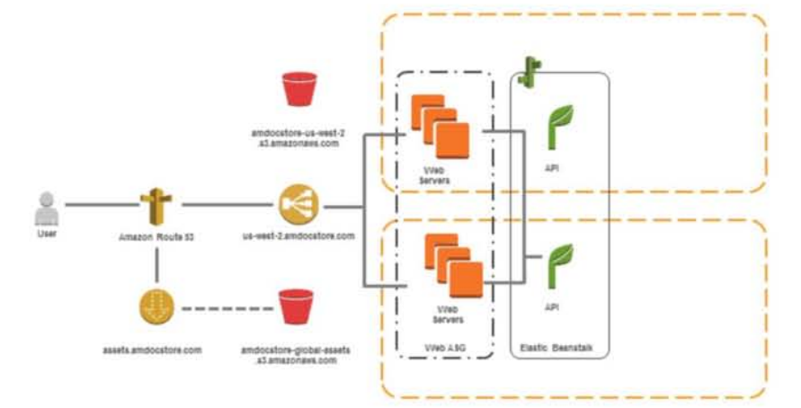
DocStore
Let’s see what happens when a user wants to upload a PDF document

Slide 59
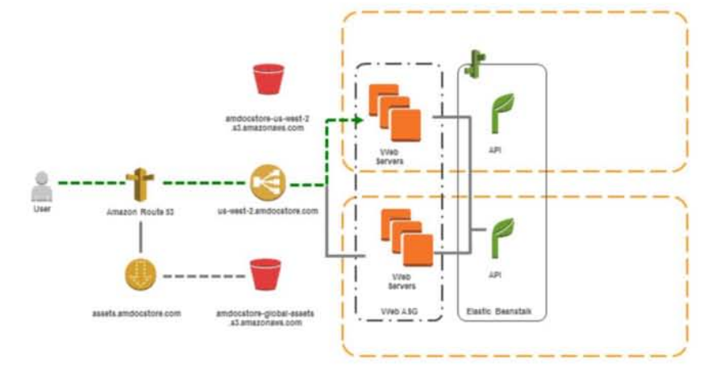
DocStore
Upload Document: An authenticated user requests the upload document page from the web servers

Slide 60
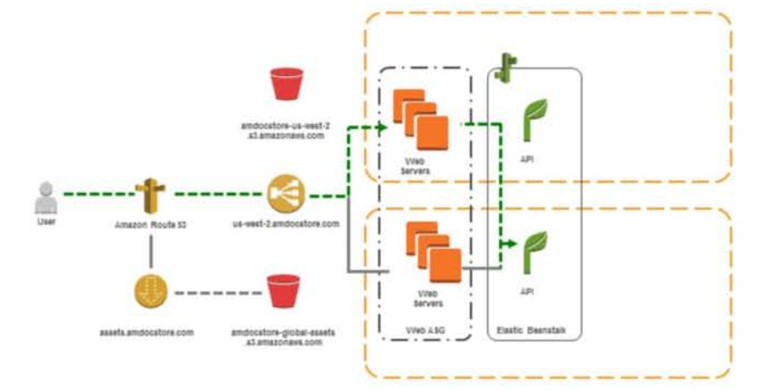
DocStore
Upload Document: The web servers request a signed HTLM form from the API and return it to the user’s browser

Slide 61
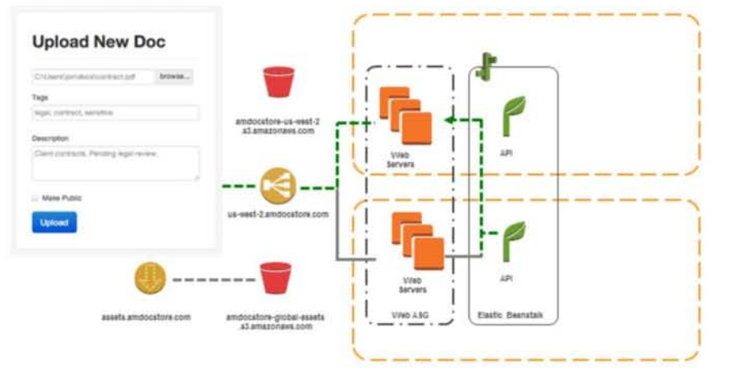
DocStore
Upload Document: The signed form is delivered to the user’s browser

Slide 62
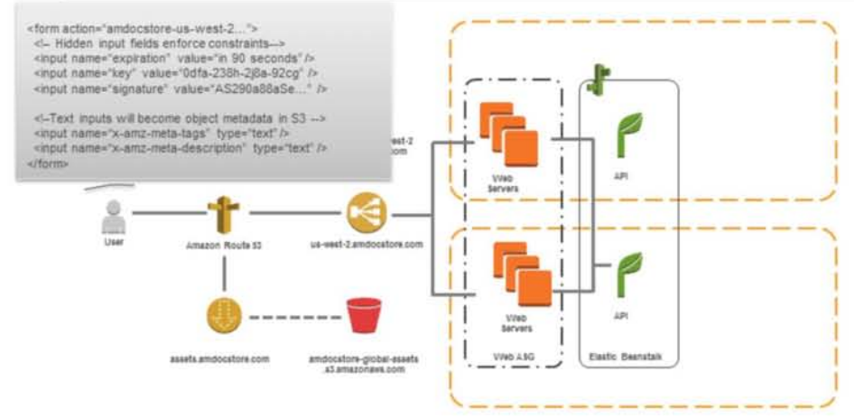
DocStore
Upload Document: The signed form allows the user to upload his document directly to S3

Slide 63
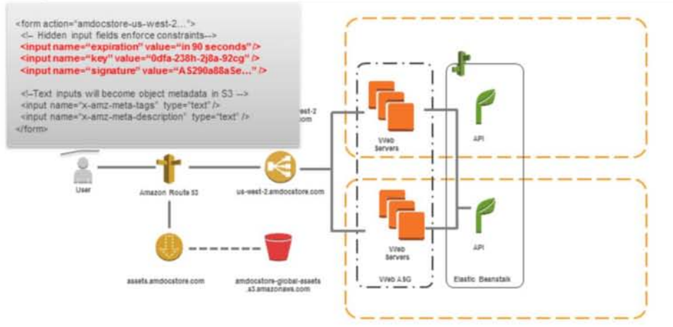
DocStore
Upload Document: The form includes some hidden inputs that constrain what the user can upload.

Slide 64
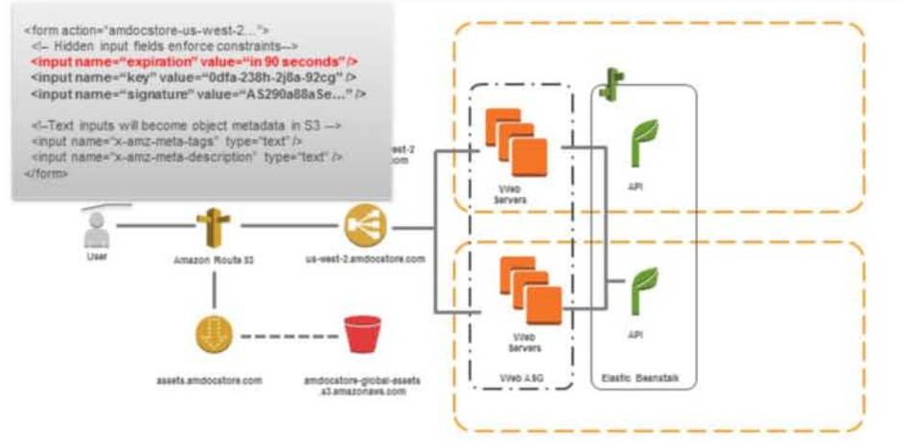
DocStore
Upload Document: The form includes some hidden inputs that constrain what the user can upload. The expiration indicates for how long the form is valid

Slide 65
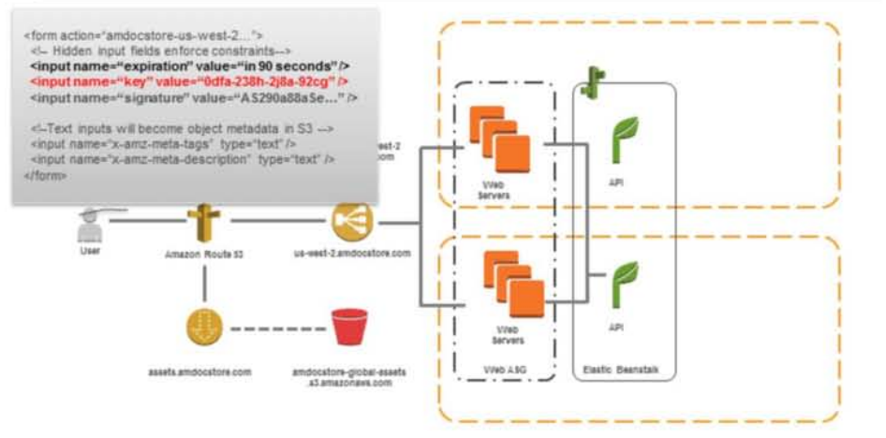
DocStore
Upload Document: The form includes some hidden inputs that constrain what the user can upload. The key allows us to specify what the object will be called in S3 (thus avoiding naming conflicts)

Slide 66
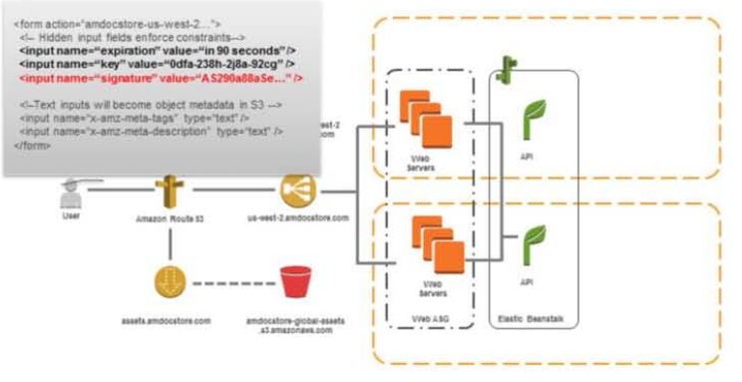
Upload Document: The form includes some hidden inputs that constrain what the user can upload. The signature ensures the upload will be rejected if the form is tampered with
DocStore

Slide 67
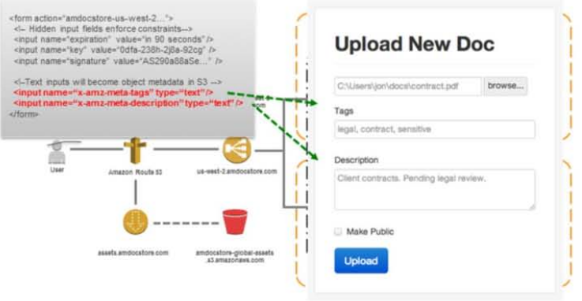
Upload Document: User-editable text input fields prefixed with x-amz-meta-will be associated with the uploaded object as S3 object metadata
DocStore

Slide 68
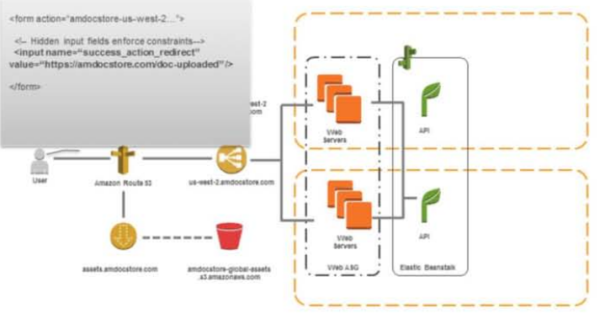
Upload Document: Finally, the success_action_redirect specified when the API generated the form tells S3 where to redirect the user’s browser when the upload completes
DocStore

Slide 69
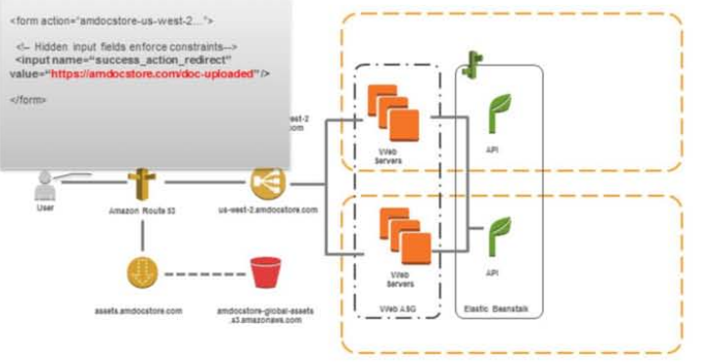
Upload Document: We send the user to a special page on the web servers that will capture this event
DocStore

Slide 70
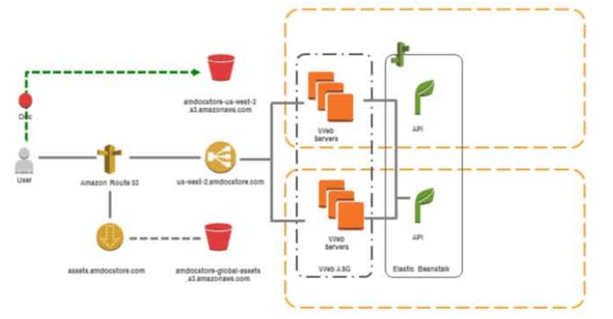
Upload Document: While uploading the document to S3
DocStore

Slide 71
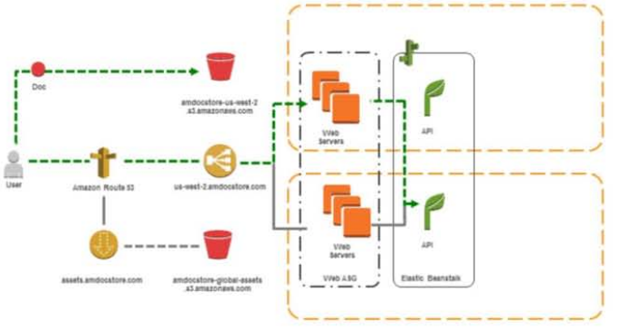
Upload Document: While uploading the document to S3, we asynchronously notify the web servers that the upload has begun
DocStore

Slide 72
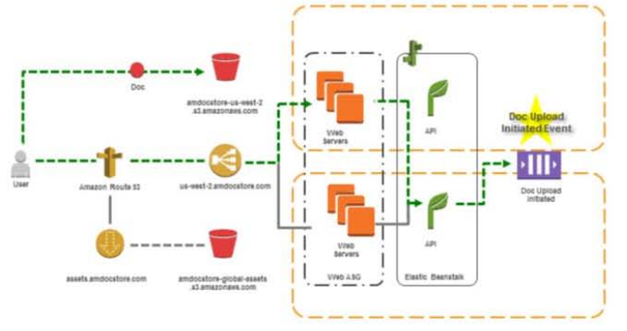
Upload Document: The API places a message in a queue indicating as much. Other components of DocStore may be interested in this event later
DocStore

Slide 73
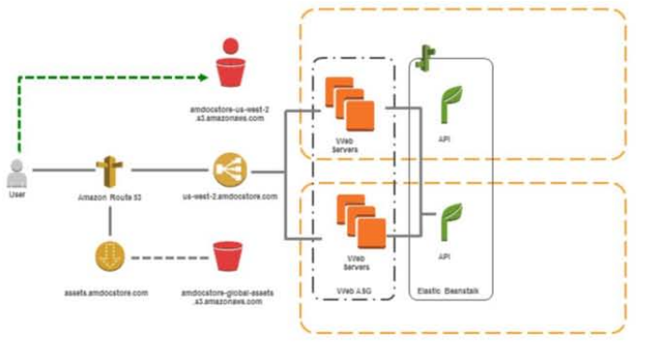
Upload Document: When the upload completes
DocStore

Slide 74
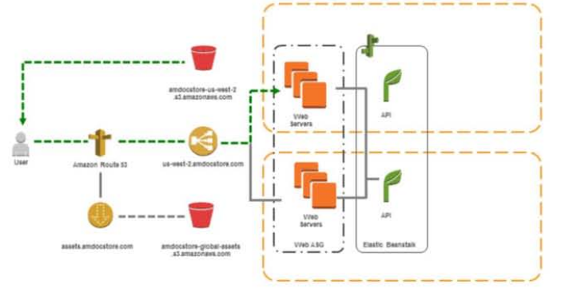
Upload Document: When the upload completes S3 redirects the users to the URL we specified earlier
DocStore

Slide 75
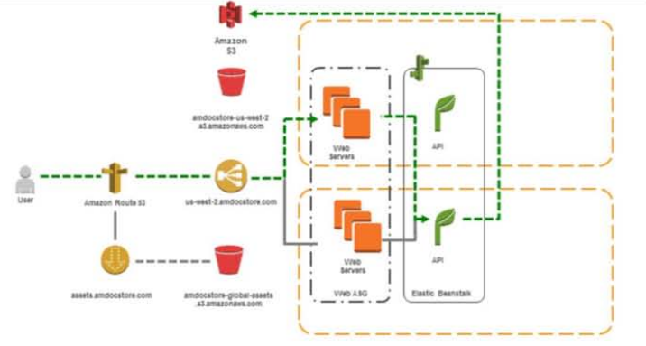
Upload Document: The API retrieves metadata about the object from the S3 API
DocStore

Slide 76
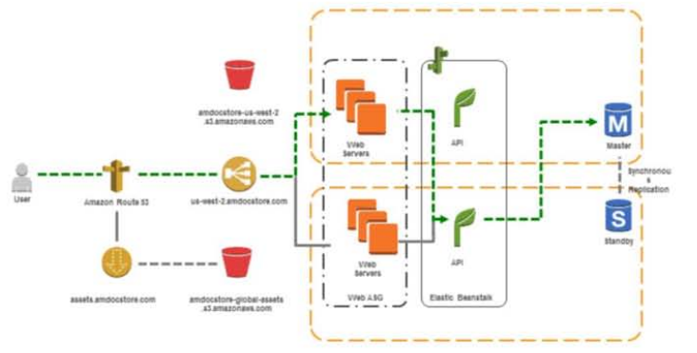
Upload Document: The Object metadata is stored in an RDS instance running in Multi-AZ mode for high availability
DocStore

Slide 77
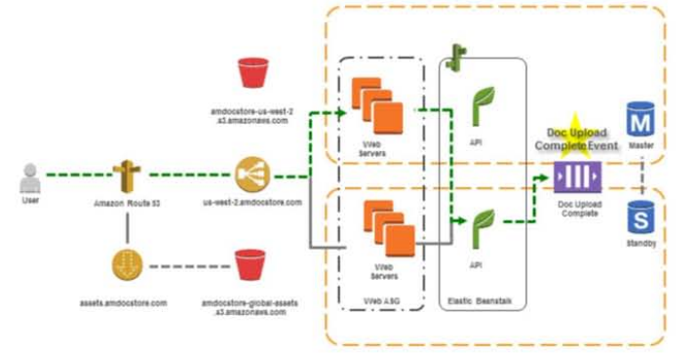
Upload Document: Finally, the API places a message in a queue indicating that the document upload was complete, and includes the ID of the newly uploaded object in S3
DocStore

Slide 78
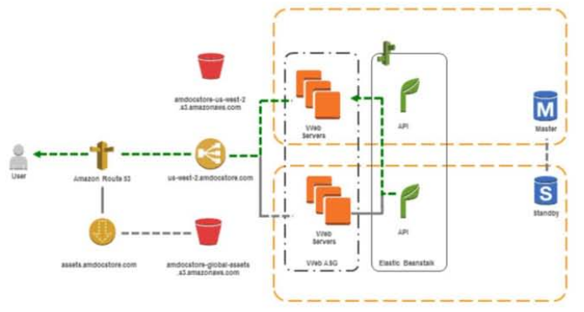
Upload Document: The user is redirected to a list of his documents
DocStore

Slide 79
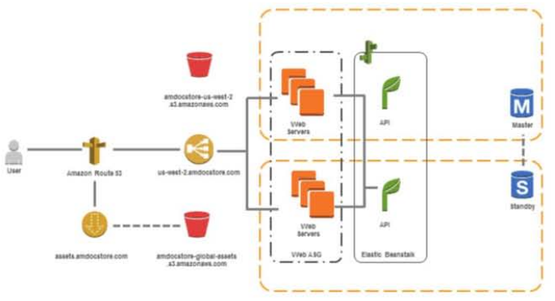
Let’s see what happens when a user wants to view and download his documents
DocStore

Slide 80

View and Download Docs: An authenticated user requests the web site URL to view his docs
DocStore

Slide 81

View and Download Docs: To increase read performance of the relational database, multiple RDS Read Replicas are provisioned. Read Replicas are suitable for read workloads, like the api selecting a list of documents owned by a user
DocStore

Slide 82

View and Download Docs: ElasticCache Cluster in front of the Read Replicas would provide additional performance when listing the user’s documents
DocStore

Slide 83

View and Download Docs: The API first checks the cache for a recent list of the user’s documents
DocStore

Slide 84

View and Download Docs: If no cached data is available, the API chooses one of the Read Replicas and queries for the list of documents
DocStore

Slide 85

View and Download Docs: The result of the query is stored in the cache for future access
DocStore

Slide 86

View and Download Docs: For each document, the API constructs a secure, auto-expiring, signed URL that will allow the user to download the document directly from S3
DocStore

Slide 87

View and Download Docs: The list of documents- and links for direct, secure download-are delivered to the user’s browser
DocStore

Slide 88

View and Download Docs: The user may download documents directly from S3
DocStore

Slide 89

View and Download Docs: Let’s look at options for security
DocStore

Slide 90

View and Download Docs: Where can security measures and controls be implemented in this architecture?
DocStore

Slide 91

View and Download Docs: User downloads documents directly from S3 using a secure, signed URL and over SSL
DocStore

Slide 92

View and Download Docs: SSL connection between user and ELB
DocStore

Slide 93

View and Download Docs: Security Groups restrict inbound traffic
DocStore

Slide 94

View and Download Docs: Access logs from CloudFront, EC2, and S3 are pushed to S3
DocStore

Slide 95

View and Download Docs: Logs are processed on a schedule using Elastic MapReduce cluster
DocStore

Slide 96

Let’s focus on the networking environment
DocStore

Slide 97

Let’s focus on the networking environment
DocStore

Slide 98

VPC: this VPC is in us-west-2 and has a 10.0.0.0/16 CIDR block
DocStore

Slide 99

VPC: We define two subnets that our ELB will run in (note: although we show the ELB in multiple subnets, this is still a single ELB)
DocStore

Slide 100

VPC: These subnets should be public. We will attach an Internet Gateway and define a Route Table entry to make them public
DocStore

Slide 101

VPC: Web servers run in a private subnet, but have outbound internet access via an EC2 instance in the public subnet running NAT
DocStore

Slide 102

VPC: The DocStore API running on Elastic Beanstalk is deployed in both a public and private subnet
DocStore

Slide 103

VPC: Finally, the RDS and ElastiCache instances are deployed in a private subnet
DocStore

Slide 104

CloudFormation: Entire application is deployed as a stack from a template file
DocStore

Slide 105

CloudFormation: The sample template file is used to deployed to us-west-2
DocStore

Slide 106

CloudFormation: and ap-southeast-2
DocStore

Slide 107
DocStore
#2. Batch processing Back-End

Slide 108
DocStore
#2. Batch processing Back-End
Sync user account
Enforce max storage limits
Extract and index based on document type
Detailed dashboard with system-wide totals:
# docs, avg, doc size, total storage

Slide 109
DocStore
#2. Batch processing Back-End
Responds to events triggered by Web interface

Slide 110

DocStore
#2. Batch processing Back-End
Responds to events triggered by Web interface

Slide 111

DocStore
#2. Batch processing Back-End
Responds to events triggered by Web and Mobile interfaces

Slide 112

New Account Create Event: Triggered when a user creates a new account. Event message in queue includes username, password and home region
DocStore

Slide 113

New Account Created Event: Triggered when a user creates a new account, event message in queue includes username, password and home region
DocStore

Slide 114

New Account Created Event: An instance running the Account Synchronization service polls the New Account Event Queue
DocStore

Slide 115

New Account Created Event: If the instance fails, Auto Scaling will launch a replacement
DocStore

Slide 116

New Account Created Event: Account Synchronizer invokes API in ap-southeast-2 to synchronize new user’s account data
DocStore

Slide 117

New Account Created Event : When a user begins uploading a document to S3, an event is triggered so the upload can be tracked via workflow
DocStore

Slide 118

New Account Created Event : When an event is received from the queue, the workflow initializer kicks off a SWF workflow execution
DocStore

Slide 119

Doc Uploaded Initiated Event: When a event is received from the queue, the workflow initializer kicks off a SWF workflow execution
DocStore

Slide 120

Doc Uploaded Initiated Event: A an instance running Decider code receives the workflow execution started task, and schedules a Check Upload Status activity
DocStore

Slide 121

Doc Uploaded Initiated Event: A an instance running the Activity Worker code receives the Check Upload Status task
DocStore

Slide 122

Doc Uploaded Initiated Event: The Activity Worker periodically checks S3 to determine if the doc upload has completed
DocStore

Slide 123

Doc Uploaded Initiated Event: Once the document is deleted in S3, a final is scheduled in the near future to ensure that the document has been property processed by the Doc Upload Complete workflow
DocStore

Slide 124

Doc Uploaded Initiated Event: When a document upload has been complete, it needs to be processed
DocStore

Slide 125

Doc Uploaded Initiated Event: A workflow initializer determines the appropriate workflow to initiate
DocStore

Slide 126

Doc Uploaded Initiated Event: A decider schedules the appropriate activity based on the document type
DocStore

Slide 127

Doc Uploaded Initiated Event: the content-length metadata property of every object should be retrieved from S3 and used to increment a counter tracking the total size of all uploaded objects
DocStore

Slide 128

Doc Uploaded Initiated Event: a counter tracking the total content size uploaded by each users is also incremented. If the new doc causes the user to exceed his allocated amount, a flag is set and the user will receive an email via SES
DocStore

Slide 129

Doc Uploaded Initiated Event: if the document was uploaded by a premium user and it has text context, the full-text content will be indexed in CloudSearch
DocStore

Slide 130

Doc Uploaded Initiated Event: Finally, several custom metrics are also put to CloudWatch, allowing us to monitor how many new documents are being uploaded by users type, how big the documents are, etc.
DocStore

